Slide 1
Kubernetes
ASSIGNMENT :- 4
Guided by :-
Ashish Mittal
Created By :-
Himanshu Singh

Slide 2
About Kubernetes :-
it is also known as k8s. because there is 8 charector in between k and s.
it is an open source tool.
it is an orchastrian tool . So, it can manages many objects/resources at once.
it can manges containerzied applications across the multiple hosts.
that means we have to create a cluster.
cluster :- group of nodes.
in our cluster, there will be atleast one master node and n number of the worker nodes.
Note :- if we have only one node in our cluster that is known minikube.

Slide 3
Worker-node:-
Master node:-
it is also known as control-plane.
it is resopniable to manage the cluster.
it is also responsible to mange the worker node.
it is resopnsible to manage configuration.
it is also known as data-plane.
it will always manged by master-node
every resource will be deployed on the worker node
however we can deploy the resource on the master node also.
Note :- it is written in the GO language.

Slide 4
Advantages of the Kubernetes:-
it is an orchastrian tool.
it supports auto-scalling.
it supports load-balancing
it is fault-tolerant.
it supports roll-back
it works on the mulitple hosts.
it support HA(high avalibility)
it provides us the project level isolation with the help of namespace.

Slide 5
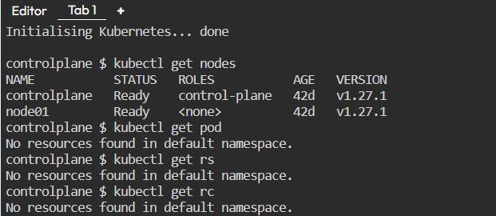
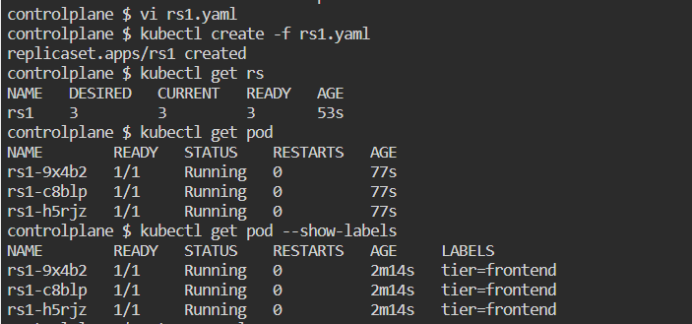
Nodes:-
Creating Replicaset (rs1.yaml)

Slide 6
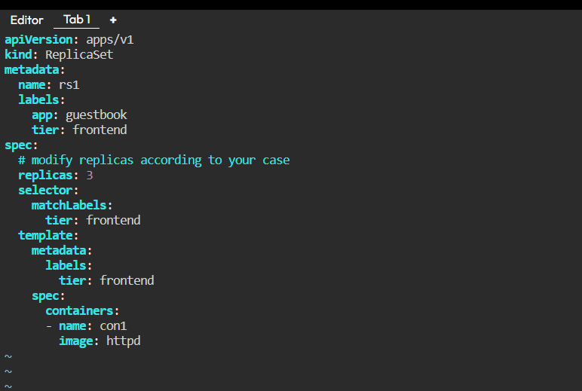
rs1.yaml file

Slide 7
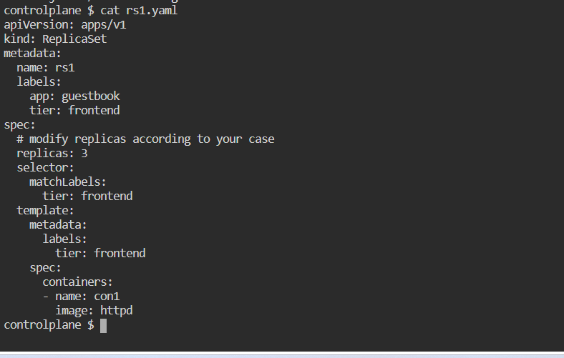
cat rs1.yaml :- To see the content of rs1.yaml file

Slide 8
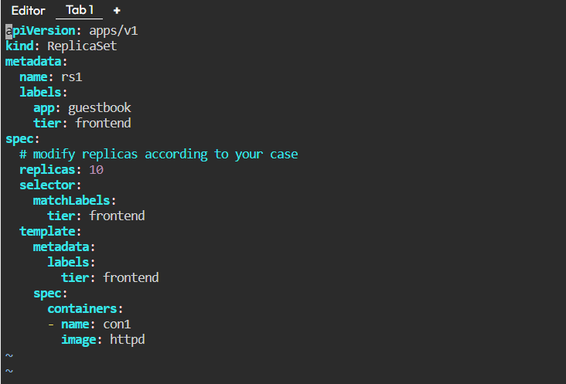
To Change Replicas from 3 to 10
edit in rs1.yaml file change replicas from 3 to 10.

Slide 9
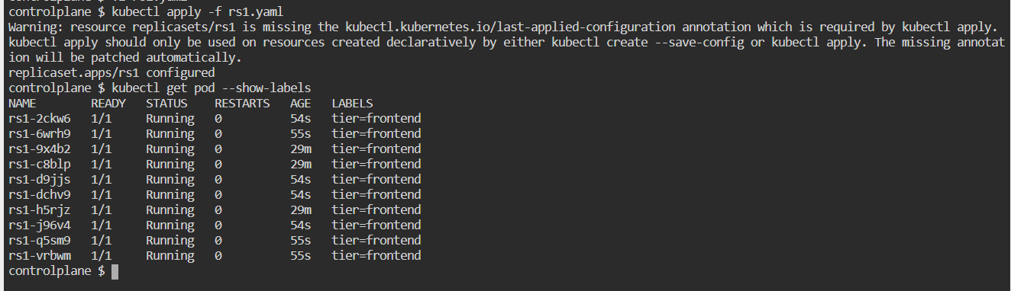

Slide 10
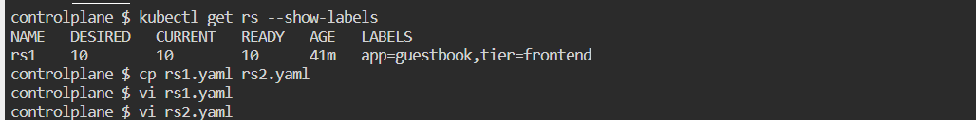
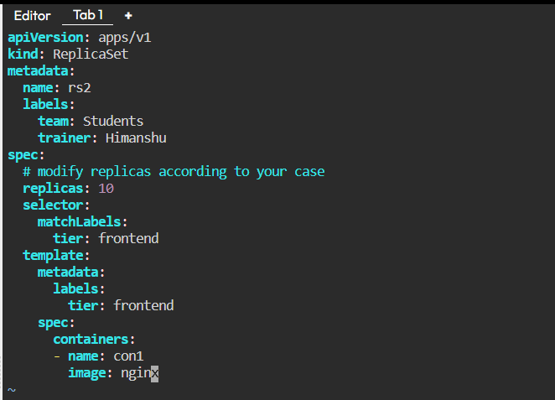
edit in rs2.yaml file change replicas from 3 to 10.
rs2.yaml

Slide 11
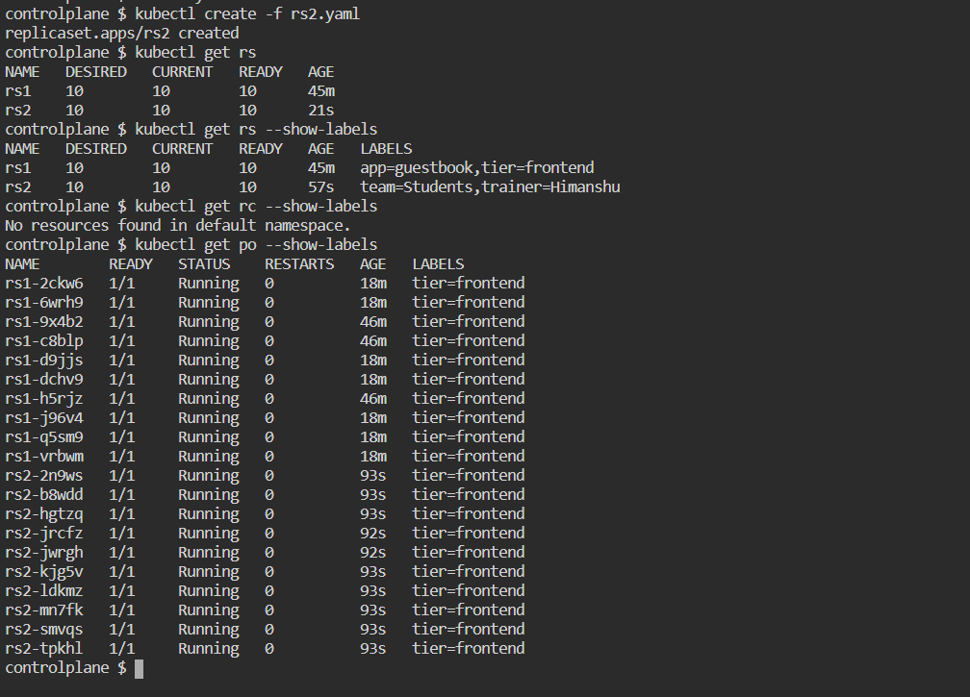

Slide 12
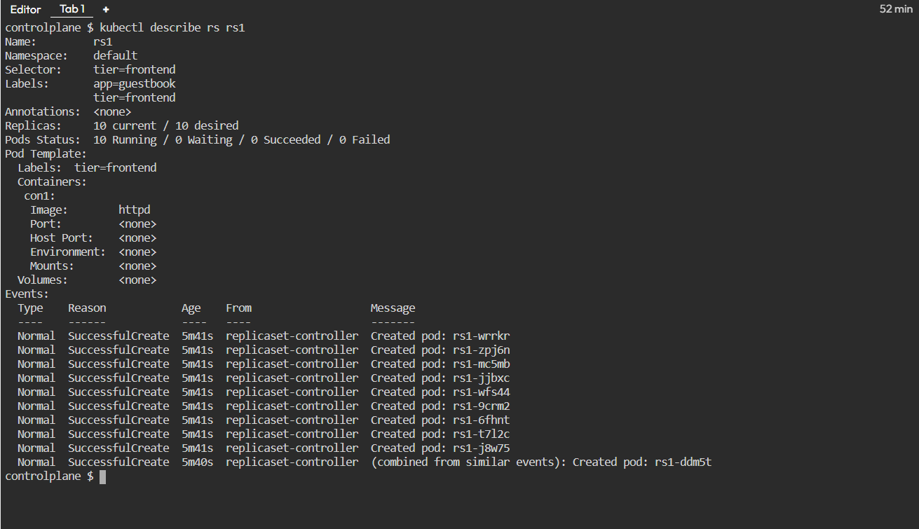

Slide 13
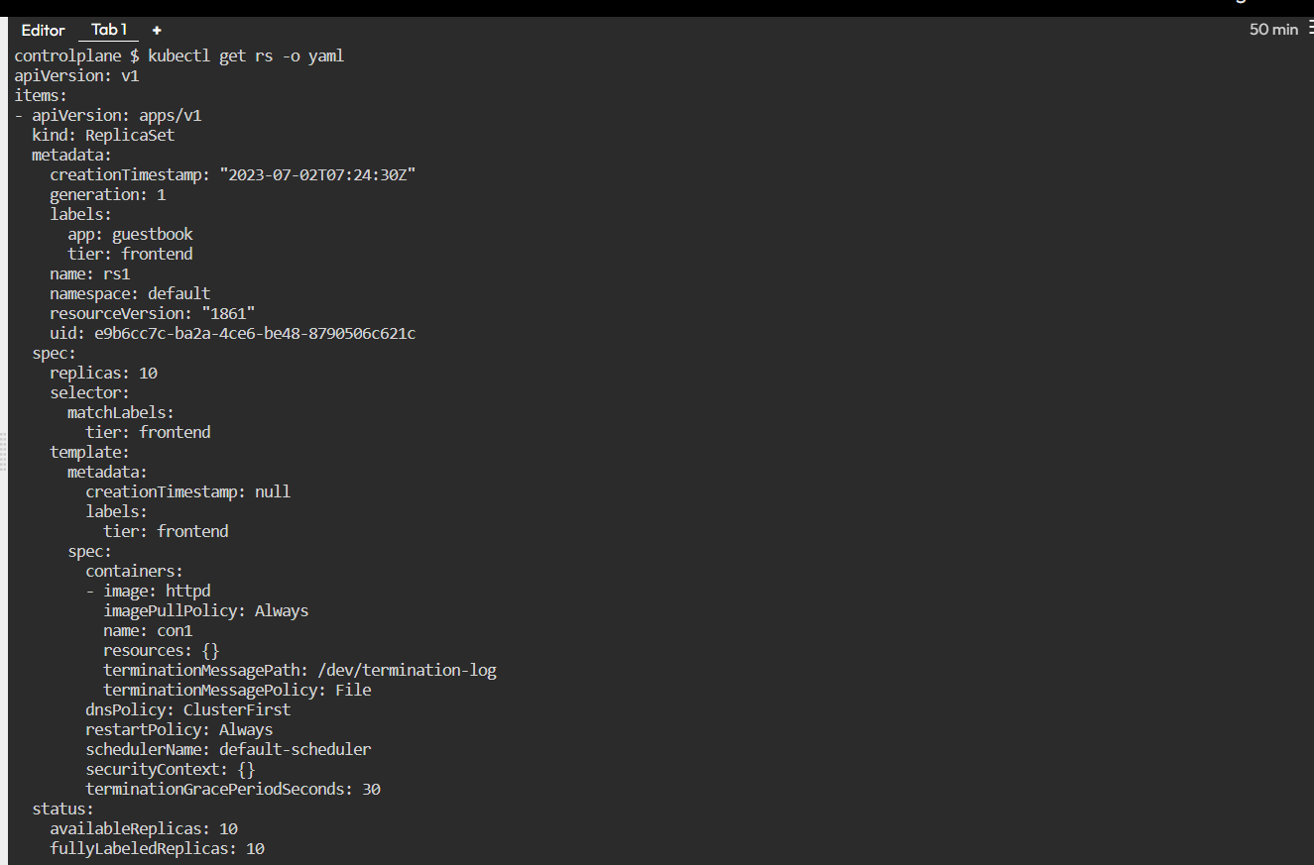

Slide 14
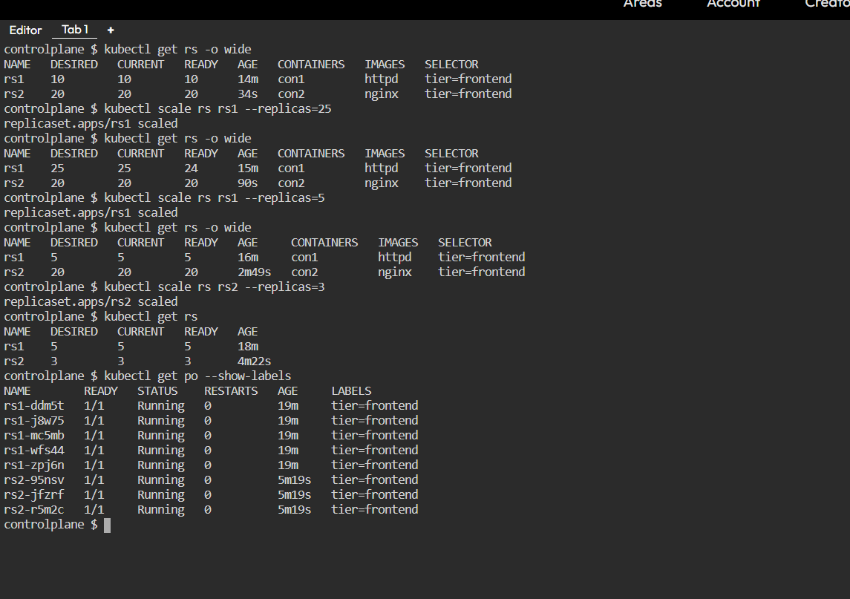
Scale up and Scale Down of Replicas

Slide 15
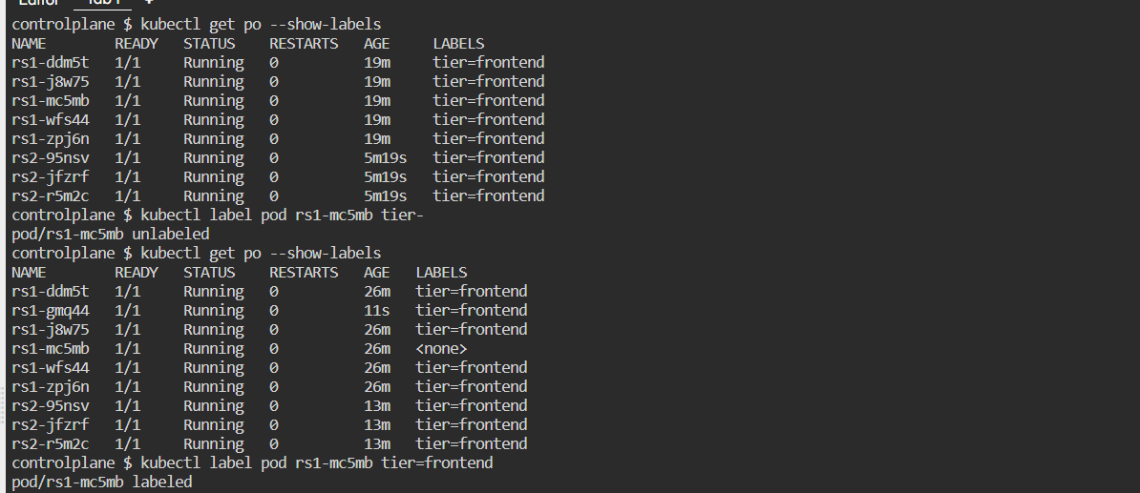
Label and Unlabel

Slide 16
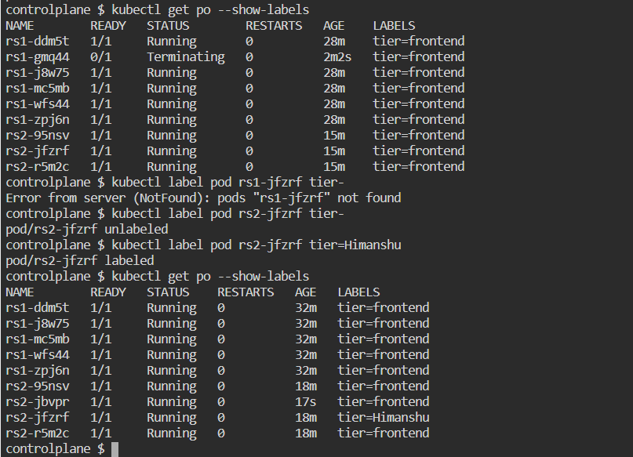
Label and Unlabel

Slide 17
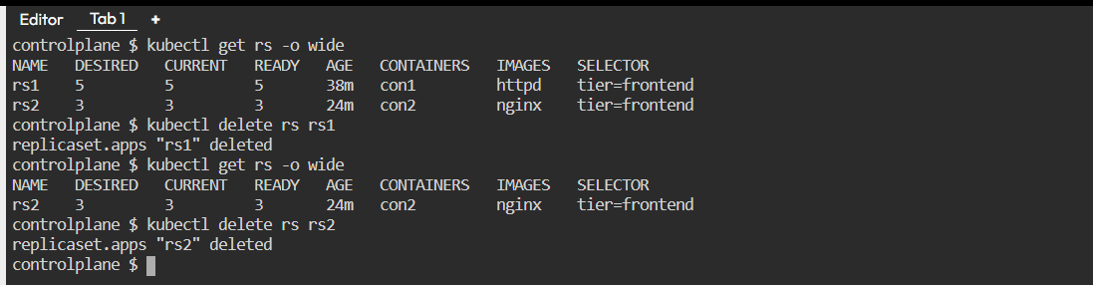
Delete rs rs1 & rs2.

Slide 18
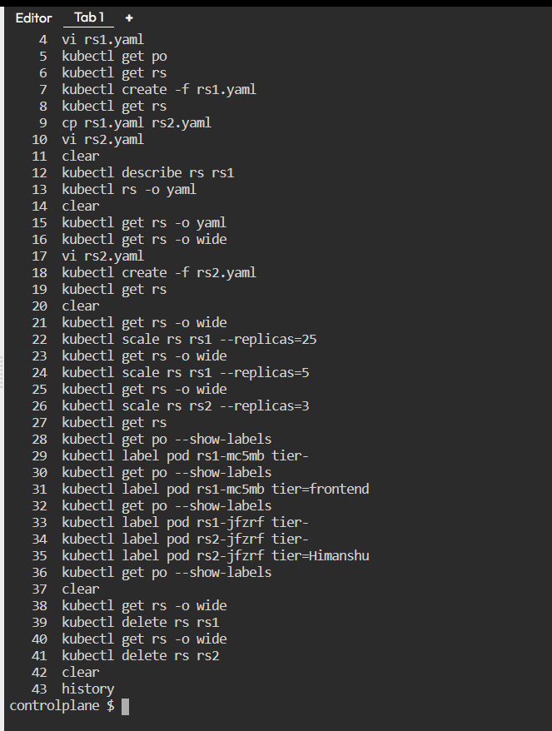
All Commands , History

Slide 19
Thank You....

